Slide 1

KISHKINDA UNIVERSITY Mount View Campus, off 28 km, Ballari-Siruguppa Road, Near Sindhigeri, GP No:735, Hagalur, Siruguppa Taluk, Ballari District-583 120, Karnataka. MINI PROJECT “FAN ENGAGEMENT PORTAL POC” Submitted by: K Anjali KUB23CSE048 K Keerthi KUB23CSE050 J Charitha Shree KUB23CSE044 Khushi G Neeli KUB23CSE066 Chaitra KUB23CSE030

Slide 2
INTRODUCTION The Fan Engagement Portal is designed to enhance the interaction between fans and organizations by providing a structured platform for managing fan data, conducting surveys, and generating reports. The system is modular, which allows for easy maintenance and scalability.

Slide 3
OBJECTIVE The objective of a fan engagement portal is to foster a vibrant community by providing fans with interactive tools and content that enhance their connection to the brand or team. This includes facilitating communication, offering exclusive content, organizing events, and enabling user-generated contributions, all aimed at increasing fan loyalty and participation.

Slide 4
Vision To create a vibrant and immersive digital community where fans can engage deeply and personally with their favorite teams, artists, or brands. To become the leading platform for fan interaction by offering innovative, personalized experiences that connect and inspire fans globally.

Slide 5
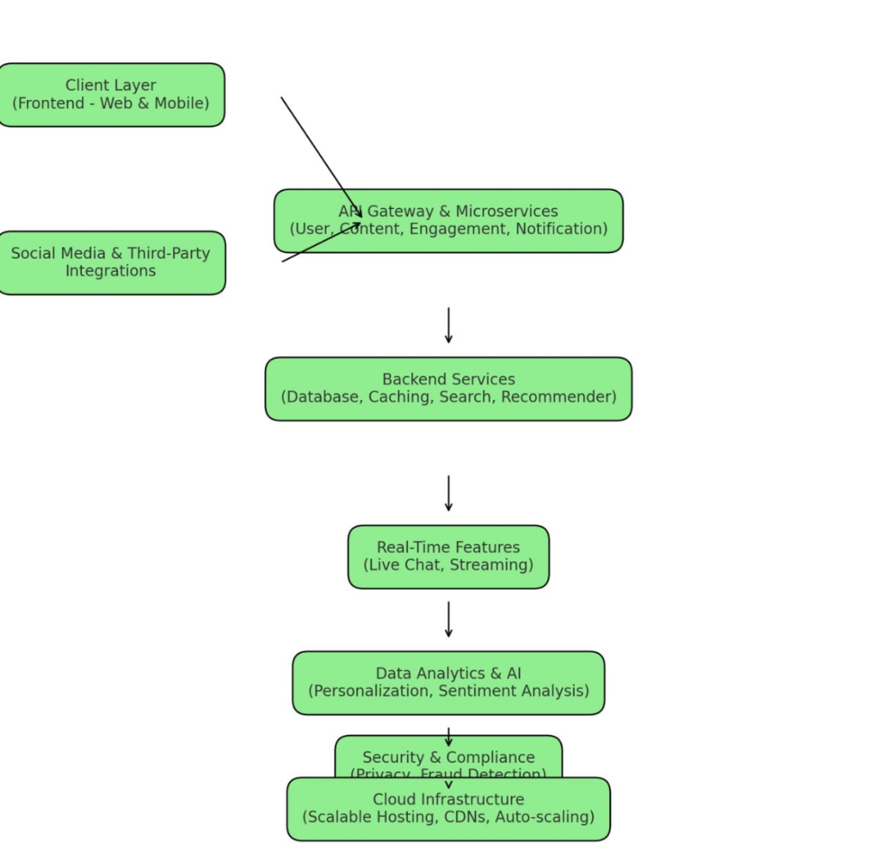
ARCHITECTURE

Slide 6
FUTURE ENCHANCEMENT
As technology advances and fan expectations grow, fan engagement portals are evolving rapidly. Here are several future enhancements that could significantly improve these platforms:
Real-Time Interaction
Enhanced Social Connectivity
AI-Powered Personalization and Predictive Engagement
Fan-Driven Content and Collaboration
Enhanced Social Connectivity and Community Building

Slide 7
KEY CONCEPTS
Fan Data Management: To efficiently handle the information related to fans, including their profiles and preferences
Survey Management: To create, conduct, and analyze surveys that gauge fan satisfaction and preferences.
Report Generation: To compile data from surveys and present it in a meaningful way for analysis.

Slide 8
BENEFITS
A fan engagement portal offers a variety of benefits for both the brand, team, or artist and the fans. These include:
Strengthened Fan Loyalty
Enhanced Fan Experience
Direct Communication with Fans
Brand Growth and Visibility

Slide 9
DRAWBACKS
Data privacy and security concerns.
Negative feedback amplification.
Technical glitches.
Limited personalization.
Overwhelming fan expectations.

Slide 10
CONCLUSION
1.Builds Stronger Connections: The portal helps brands strengthen relationships with their fans.
2. Personalized Experiences: Fans get personalized content, exclusive rewards, and interactive activities.
3. Fosters Community: It creates a sense of belonging and community among fans.
4. Gathers Valuable Insights: The portal provides insights into fan preferences and behaviors, helping brands improve their offerings.
5. Boosts Loyalty and Engagement: It enhances fan loyalty and increases engagement with the brand.
6. Long-term Value: The platform creates lasting value for both the fans and the company.
7. Not Just a Marketing Tool: It acts as a bridge connecting brands with their most passionate supporters.

Slide 11
REFERENCES https://www.geeksforgeeks.org https://www.w3schools.com

Slide 12


